Slide 1
Woman in white
Wilkie Collins

Slide 2
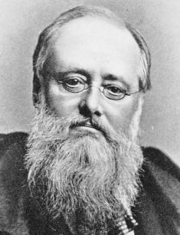
Wilkie (william) collins
He was born in London in 1824 8th January. Wilkie was educated privately and discovered his gift for storytelling while he was still a schoolboy. He was in buisnes for a few years and studied law, but he spent most of his life as writer. His private life was very unusual for those times; he lived for a few years with a woman called Caroline Graves and at the same time he kept Martha Rudd, the mother of his three children. He did not marry either of them. Charles Dickins was his friend, who had a great influence on him
Collins died in 1889. On his grave inscribed words that he wanted: Author of The Woman in White and other works.
Like many of his readers, Collins regarded The Woman in White as his best novel.

Slide 3
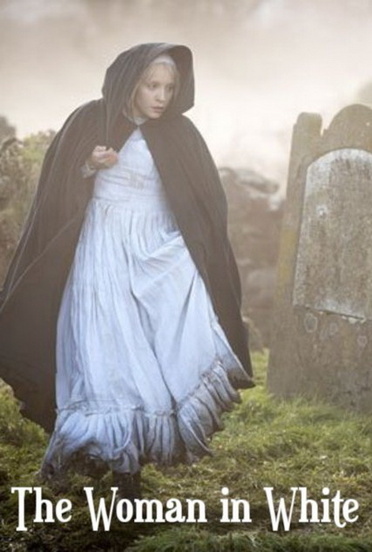
Woman in white (description)
Woman in White is a detective book and it is about mess young woman and who linked the things and people. Walter falls in love with his one of his pupil (Laura) and they will will be seperated later because of Laura’s merryage with cruel man who only wants her money and he had a big secret which Woman in White, same as Anne, knew, but unfortunately she will die and secret was disclosure before her mum would say it Walter but Laura’s husband also will die. Finally Walter and Laura will get married and have a son.

Slide 4
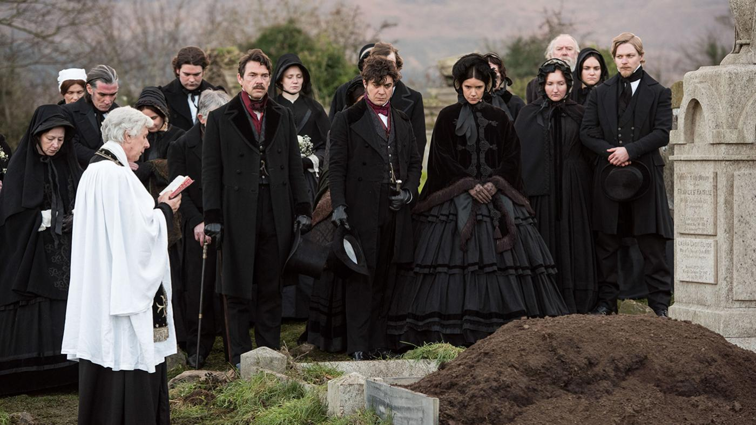
Favourite part
The most beloved part of this book was when Walter heard about Laura’s “death” and he vent on her “grave”. He says: I knelt by the grave, laid my head on the white stone, thinking about Laura, my lost love… And then I imagined it the most clear as posible as it was, imagined what he had experiented, when he placed his head on the cold stone but not lover one’s knee.

Slide 5
Favourite character
In my opanion Marrian (Laura’s sister) was the most positive character because she could help others and she could given advice

Slide 6
Woman in white film
The Woman in White is a 1948 drama film directed by Peter Godfrey which stars Alexis Smith, Eleanor Parker, Sydney Greenstreet and Gig Young. The s reenplay is based on Wilkie Collins novel The Woman in White (1860)

